Slide 1
Overview

Slide 2
Unity Basics

Slide 3
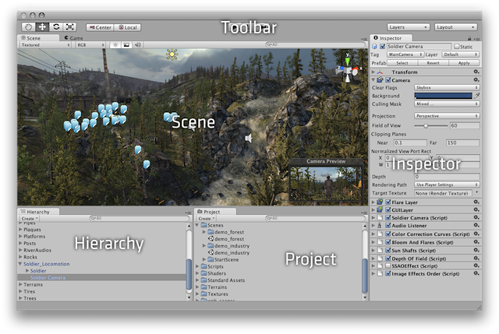

Slide 4
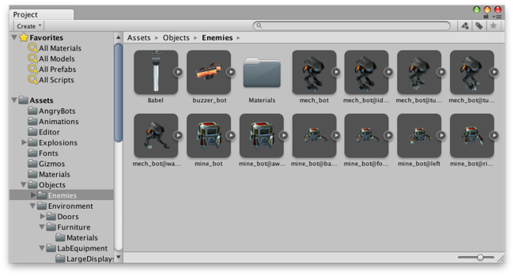

Slide 5
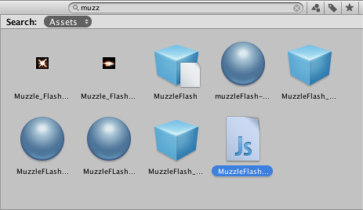

Slide 6
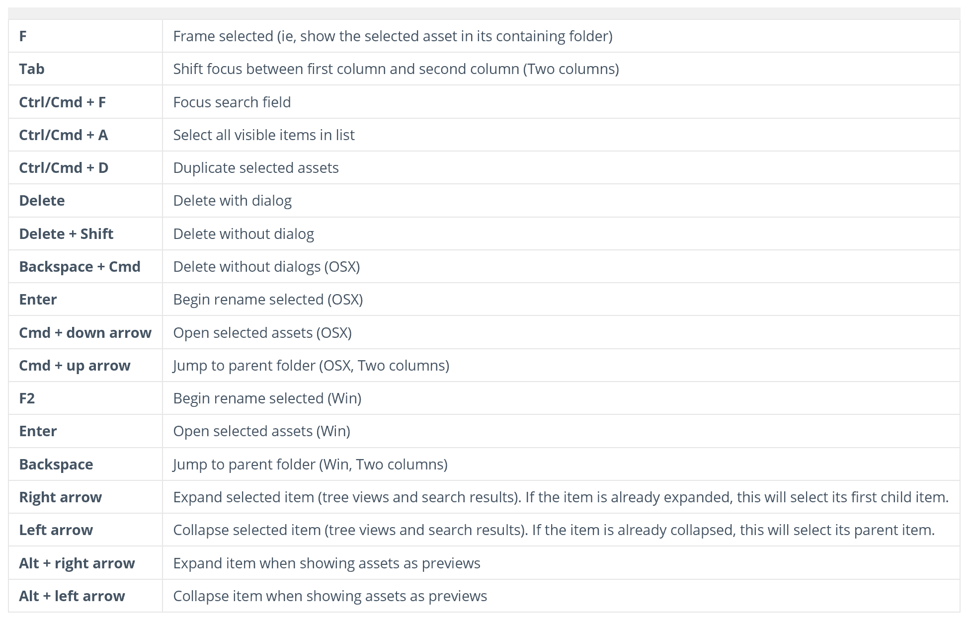
Shortcuts

Slide 7
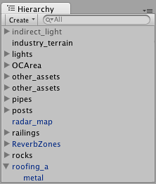
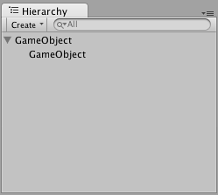
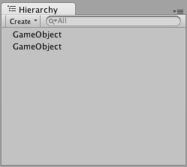

Slide 8
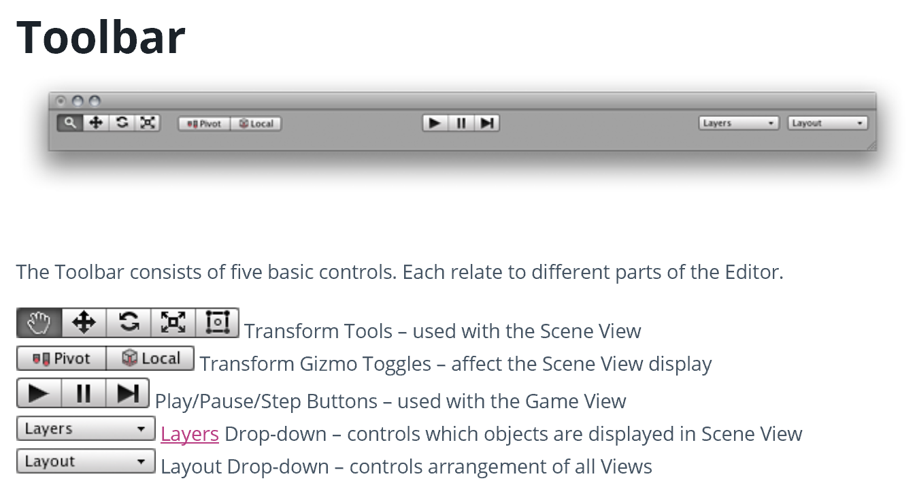

Slide 9
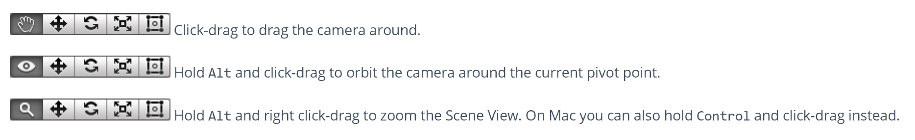
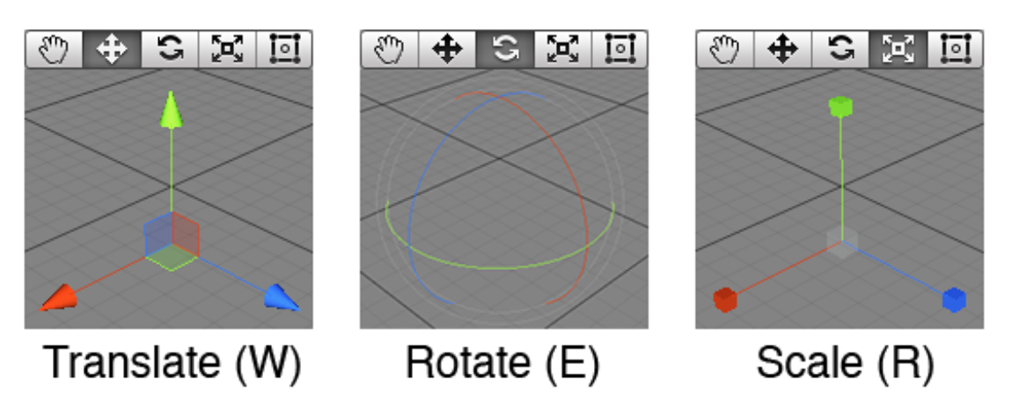
Scene View

Slide 10
Game View
The Game View is rendered from the Camera(s) in your game. It is representative of your final, published game
You will need to use one or more Cameras to control what the player actually sees when they are playing your game

Slide 11
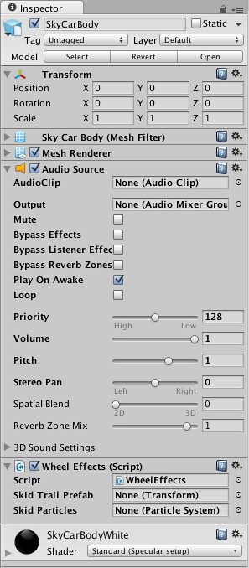
Inspector

Slide 12
Other Views
The Console shows logs of messages, warnings, and errors.
The Animation View can be used to animate objects in the scene.
The Profiler can be used to investigate and find the performance bottle-necks in your game.
The Asset Server View can be used to manage version control of the project using Unity’s Asset Server.
The Lightmapping View can be used to manage lightmaps using Unity’s built-in lightmapping.
The Occlusion Culling View can be used to manage Occlusion Culling for improved performance.

Slide 13
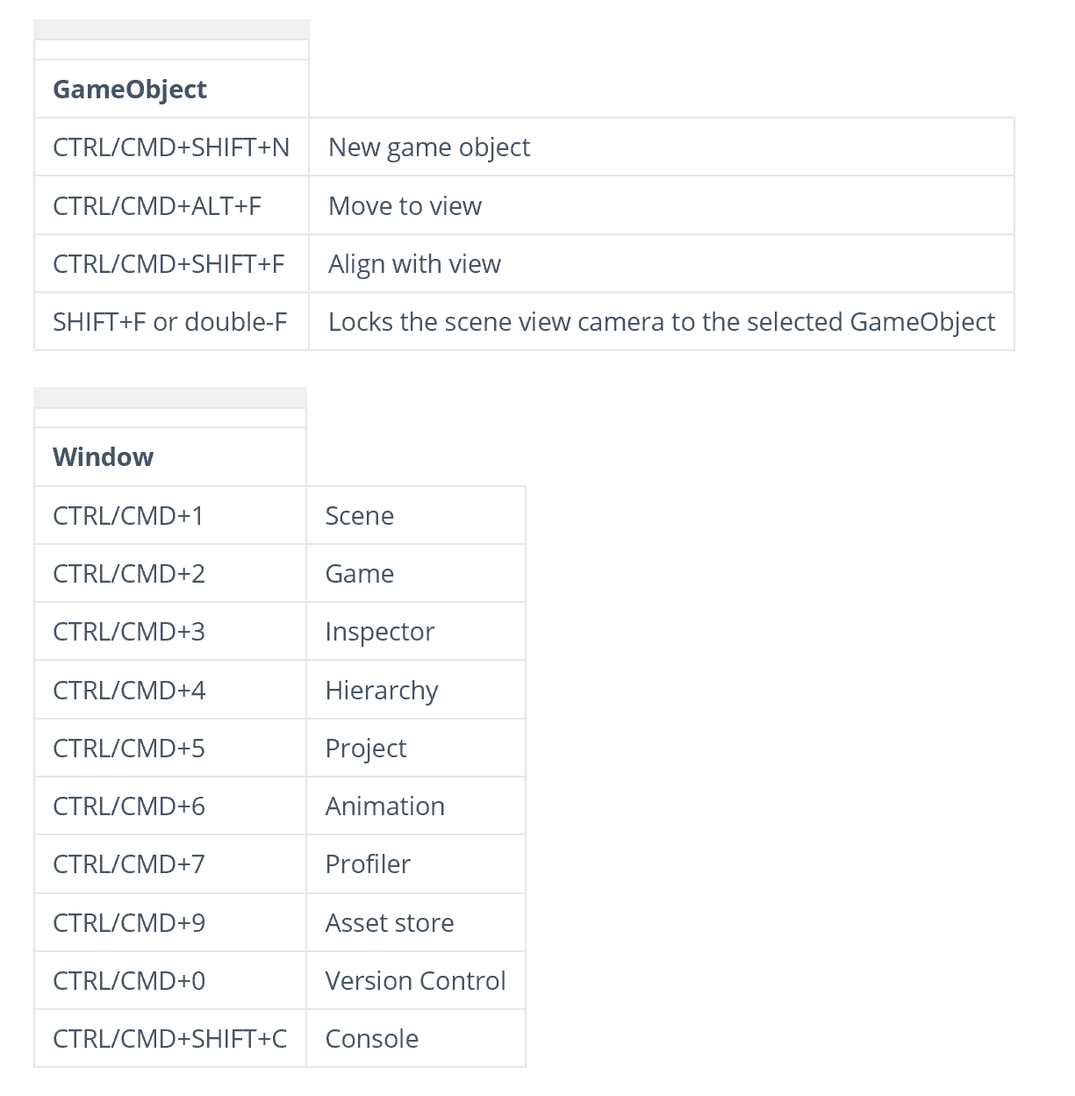
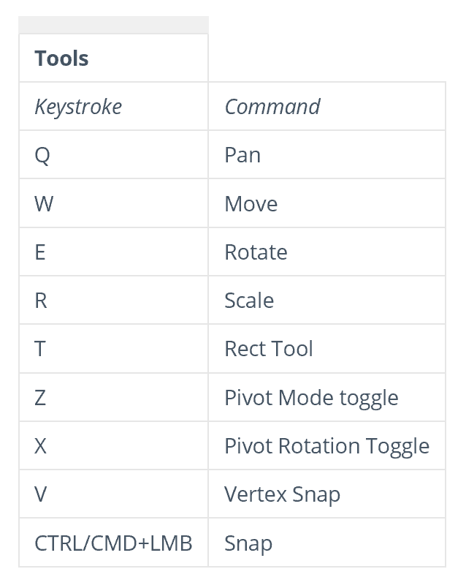
Unity Hotkeys

Slide 14
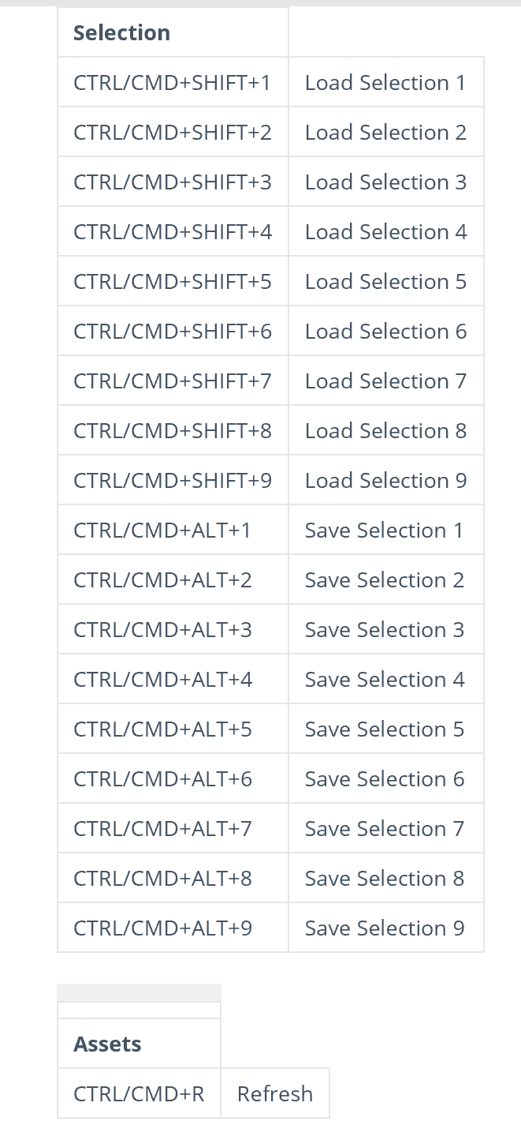
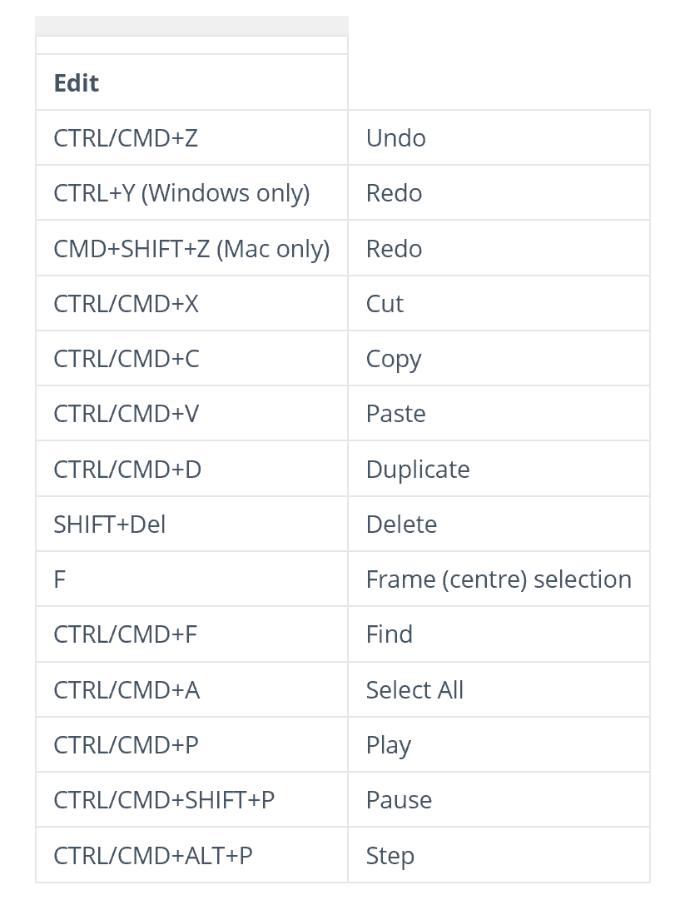

Slide 15
Static GameObjects
Many optimisations need to know if an object can move during gameplay
Information about a Static (ie, non-moving) object can often be precomputed in the editor in the knowledge that it will not be invalidated by a change in the object’s position
For example, rendering can be optimised by combining several static objects into a single, large object known as a batch.
The inspector for a GameObject has a Static checkbox and menu in the extreme top-right, which is used to inform various different systems in Unity that the object will not move
The object can be marked as static for each of these systems individually, so you can choose not to calculate static optimisations for an object when it isn’t advantageous.

Slide 16
Lightmapping: advanced lighting for a scene;
Occluder and Occludee: rendering optimization based on the visibility of objects from specific camera positions;
Batching: rendering optimization that combines several objects into one larger object;
Navigation: the system that enables characters to negotiate obstacles in the scene;
Off-mesh Links: connections made by the Navigation system between discontinuous areas of the scene.
Reflection Probe: captures a spherical view of its surroundings in all directions.

Slide 19
Porting a Project Between Platforms

Slide 20
Keyboard and joypad
The Input.GetAxis function is very convenient on desktop platforms as a way of consolidating keyboard and joypad input
However, this function doesn’t make sense for the mobile platforms which rely on touchscreen input
Likewise, the standard desktop keyboard input doesn’t port over to mobiles well for anything other than typed text
It is worthwhile to add a layer of abstraction to your input code if you are considering porting to other platforms in the future
As a simple example, if you were making a driving game then you might create your own input class and wrap the Unity API calls in your own functions:-

Slide 21
// Returns values in the range -1.0 .. +1.0 (== left .. right).
function Steering() {
return Input.GetAxis("Horizontal");
}
// Returns values in the range -1.0 .. +1.0 (== accel .. brake).
function Acceleration() {
return Input.GetAxis("Vertical");
}
var currentGear: int;
// Returns an integer corresponding to the selected gear.
function Gears() {
if (Input.GetKeyDown("p"))
currentGear++;
else if (Input.GetKeyDown("l"))
currentGear--;
return currentGear;
}

Slide 22
One advantage of wrapping the API calls in a class like this is that they are all concentrated in a single source file and are consequently easy to locate and replace
However, the more important idea is that you should design your input functions according to the logical meaning of the inputs in your game
This will help to isolate the rest of the game code from the specific method of input used with a particular platform.

Slide 23
For example, the Gears function above could be modified so that the actual input comes from touches on the screen of a mobile device
Using an integer to represent the chosen gear works fine for all platforms, but mixing the platform-specific API calls with the rest of the code would cause problems
You may find it convenient to use platform dependent compilation to combine the different implementation of the input functions in the same source file and avoid manual swaps

Slide 24
Touches and clicks
The Input.GetMouseButtonXXX functions are designed so that they have a reasonably obvious interpretation on mobile devices even though there is no “mouse” as such
A single touch on the screen is reported as a left click and the Input.mousePosition property gives the position of the touch as long as the finger is touching the screen
This means that games with simple mouse interaction can often work transparently between the desktop and mobile platforms
Naturally, though, the conversion is often much less straightforward than this. A desktop game can make use of more than one mouse button and a mobile game can detect multiple touches on the screen at a time.

Slide 25
As with API calls, the problem can be managed partly by representing input with logical values that are then used by the rest of the game code
For example, a pinch gesture to zoom on a mobile device might be replaced by a plus/minus keystroke on the desktop
the input function could simply return a float value specifying the zoom factor
Likewise, it might be possible to use a two-finger tap on a mobile to replace a right button click on the desktop
However, if the properties of the input device are an integral part of the game then it may not be possible to remodel them on a different platform
This may mean that game cannot be ported at all or that the input and/or gameplay need to be modified extensively.

Slide 26
Accelerometer, compass, gyroscope and GPS
These inputs derive from the mobility of handheld devices and so may not have any meaningful equivalent on the desktop
However, some use cases simply mirror standard game controls and can be ported quite easily
For example, a driving game might implement the steering control from the tilt of a mobile device (determined by the accelerometer). In cases like this, the input API calls are usually fairly easy to replace, so the accelerometer input might be replaced by keystrokes
However, it may be necessary to recalibrate inputs or even vary the difficulty of the game to take account of the different input method. Tilting a device is slower and eventually more strenuous than pressing keys and may also make it harder to concentrate on the display. This may result in the game’s being more difficult to master on a mobile device and so it may be appropriate to slow down gameplay or allow more time per level. This will require the game code to be designed so that these factors can be adjusted easily.

Slide 27
Memory, storage and CPU performance
Mobile devices inevitably have less storage, memory and CPU power available than desktop machines and so a game may be difficult to port simply because its performance is not acceptable on lower powered hardware
Some resource issues can be managed but if you are pushing the limits of the hardware on the desktop then the game is probably not a good candidate for porting to a mobile platform.

Slide 28
Movie playback
Currently, mobile devices are highly reliant on hardware support for movie playback
The result is that playback options are limited and certainly don’t give the flexibility that the MovieTexture asset offers on desktop platforms
Movies can be played back fullscreen on mobiles but there isn’t any scope for using them to texture objects within the game (so it isn’t possible to display a movie on a TV screen within the game, for example)
In terms of portability, it is fine to use movies for introductions, cutscenes, instructions and other simple pieces of presentation
However, if movies need to be visible within the game world then you should consider whether the mobile playback options will be adequate.

Slide 29
Storage requirements
Video, audio and even textures can use a lot of storage space and you may need to bear this in mind if you want to port your game
Storage space (which often also corresponds to download time) is typically not an issue on desktop machines but this is not the case with mobiles
Furthermore, mobile app stores often impose a limit on the maximum size of a submitted product. It may require some planning to address these concerns during the development of your game

Slide 30
For example, you may need to provide cut-down versions of assets for mobiles in order to save space
Another possibility is that the game may need to be designed so that large assets can be downloaded on demand rather than being part of the initial download of the application.

Slide 31
Automatic memory management
The recovery of unused memory from “dead” objects is handled automatically by Unity and often happens imperceptibly on desktop machines
However, the lower memory and CPU power on mobile devices means that garbage collections can be more frequent and the time they take can impinge more heavily on performance (causing unwanted pauses in gameplay, etc)
Even if the game runs in the available memory, it may still be necessary to optimise code to avoid garbage collection pauses. More information can be found on our memory management page.

Slide 32
CPU power
A game that runs well on a desktop machine may suffer from poor framerate on a mobile device simply because the mobile CPU struggles with the game’s complexity
Extra attention may therefore need to be paid to code efficiency when a project is ported to a mobile platform

